Slide 1
Affordable housing Initiatives
Marcy Esbjerg
Director
Community Development
NCDA 55th Annual Conference, Cambridge, MA

Slide 2
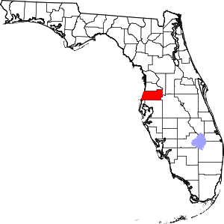
About Pasco County, FL
Population – 632,996 (just under 225,000 households)
Location – north of Tampa, FL on the Gulf of Mexico
Square Miles – 747
Owner-occupied/rental housing – 72/28%
LMI – 40% LMI, 53% Renters Cost Burdened
CDBG - $3 million
HOME - $1.2 million
ESG - $255,000

Slide 3
What’s all this about affordable housing?

Slide 4
How We Took Action in Pasco County
Local partner offered to pay for an affordable housing study; well respected Chairman of the Pasco County Housing Authority
Proposed using the local university – University of South Florida
Students in an affordable housing class did much of the research
County offered our resources and served as a liaison to the professor and students
Lesson #1: Affordable housing is too big of an issue to ‘go it alone’ in our communities. We need internal and external partners, advocates and people of influence. Don’t hesitate to use educational resources, even if YOU are the expert. Put your ego aside.

Slide 5
How to Present the Study – An Affordable Housing Workshop for the Board of County Commissioners
Study included data on renters/homeowners that are cost burdened
HUD maps
Future analysis
What is an affordable rent? What occupations qualify as LMI?
Where is the most need in our County?
Sounds like………………Our Consolidated Plan – more up to date and user friendly

Slide 6
USF Recommendations
Preserve existing affordable stock
Help current residents afford housing
Build more housing
Use land strategically
Zone for housing production
Ensure sufficient capacity to carry out robust programs
Lesson #2 – There really isn’t any new strategies in the affordable housing world. Just get it done.

Slide 7
Recommendations May Work For Your Community
Preserve and Improve Existing Housing
Assess rehab needs of older housing stock
Expand programs to help homeowners in need
Preserve existing assisted housing
Help Current Residents Afford Housing
Expand downpayment assistance programs as housing costs rise
Consider emergency rental funds for tenants to avoid homelessness

Slide 8
More Recommendations
Use Land Strategically
Identify surplus public land across jurisdictions and prioritize affordable housing development
Consider land banks or land trusts to ensure continued affordability
Build More Housing
Consider pilot program to permit Accessory Dwelling Units
Use grant funds to increase assisted housing stock
Use incentives (fee waivers, expedited permits, density bonuses) to encourage private market to build affordable
Zone for Housing Production
Consider ‘gentle density’ changes in single family neighborhoods (ADUs, duplexes, triplexes
Zone multifamily homes near transportation and jobs
Leverage density bonuses or overlay districts to encourage more affordable housing construction

Slide 9
To increase affordable housing:
We need more than our HUD or State programs
We need:
Non-profit and for-profit developers
Additional funds (bonds, tax credits, construction loans)
Zoning changes
Fee Waivers
Government concessions
Lesson #3 – If you want to move the needle on affordable housing in your community, you need more than your own programs.

Slide 10
Staff Recommended Initial Strategies To Increase Supply of Affordable Housing
Mobility/Impact Fee Reductions for Affordable Housing
Already adopted in 2023
100% reduction for housing below 80% of AMI
75% reduction for nonprofits below 120% of AMI
Not available if invoke Live Local
LDC changes to allow Accessory Dwelling Units (ADUs)
Currently only allowed in a few MPUDs
Codify the MPUD ADU standards into the LDC for all residential zoning districts
LDC changes to allow additional infill density (e.g. single family unit to duplex or quadruplex)
Identify appropriate lot sizes and infill locations with adequate land/infrastructure
Modify LDC to allow additional units as of right (no zoning change)

Slide 11
Staff Recommended Initial Strategies To Increase Supply of Affordable Housing
Inclusionary Zoning and Linkage Fees
Mandatory commitment for affordable housing set-aside for new projects
Fee in lieu (linkage fee) for those projects that choose not to comply with set-aside
Can apply to residential, non-residential and mixed-use projects
Requirement has been previously implemented in certain DRIs and MPUDs, but abandoned due to lack of a County-wide strategy
Statutory requirement that the County offset the additional cost of this requirement with other incentives
Will be requesting that Florida Housing Coalition prepare the necessary study

Slide 12
Choosing What To Bring Forward
Short term – quick win
Longer term – it’s a stretch
A ‘pet’ project
Lesson # 4 – Pick and choose your battles carefully.

Slide 13
How much can Pasco County Employees afford to pay for housing each month? (30% of Gross Income) Who qualifies for affordable housing?
$500-$835 rent
$850-$1337 rent
$1340-$1838 rent
Earning Less Than $2,800 per Month
(92 FT Employees)
Library Assistant
Customer Service Specialist II
Equipment Operator Trainee
Custodian
Animal Care Tech I
Park Ranger
Park Attendant II
Others
50% AMI
Earning $2,800-$4,458 per Month
(1478 Employees)
Firefighter/EMT
Bus Driver
Project Coordinator I & II
Library Associate
Admin Secretary
Equipment Operator
Utility Worker II
Others
80% AMI
Earning $4,460-$6,125 per Month
(1070 Employees)
Corrections Officer
FF/Paramedic
FF/EMT
Field Inspector II
Plant Operator A
Planner II
Program Coord
Others
100% AMI
43%
Of County Employees can only afford $1,337 or less per month in Housing Costs
Source: Pasco County Human Resources Assumes full-time worker, 30% of income spent on housing costs.
Notes:
732 of 3540 County Employees can afford less than $1,000 per month in housing costs.

Slide 14
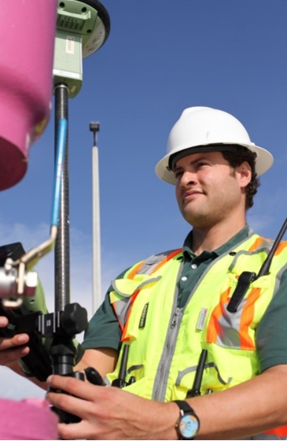
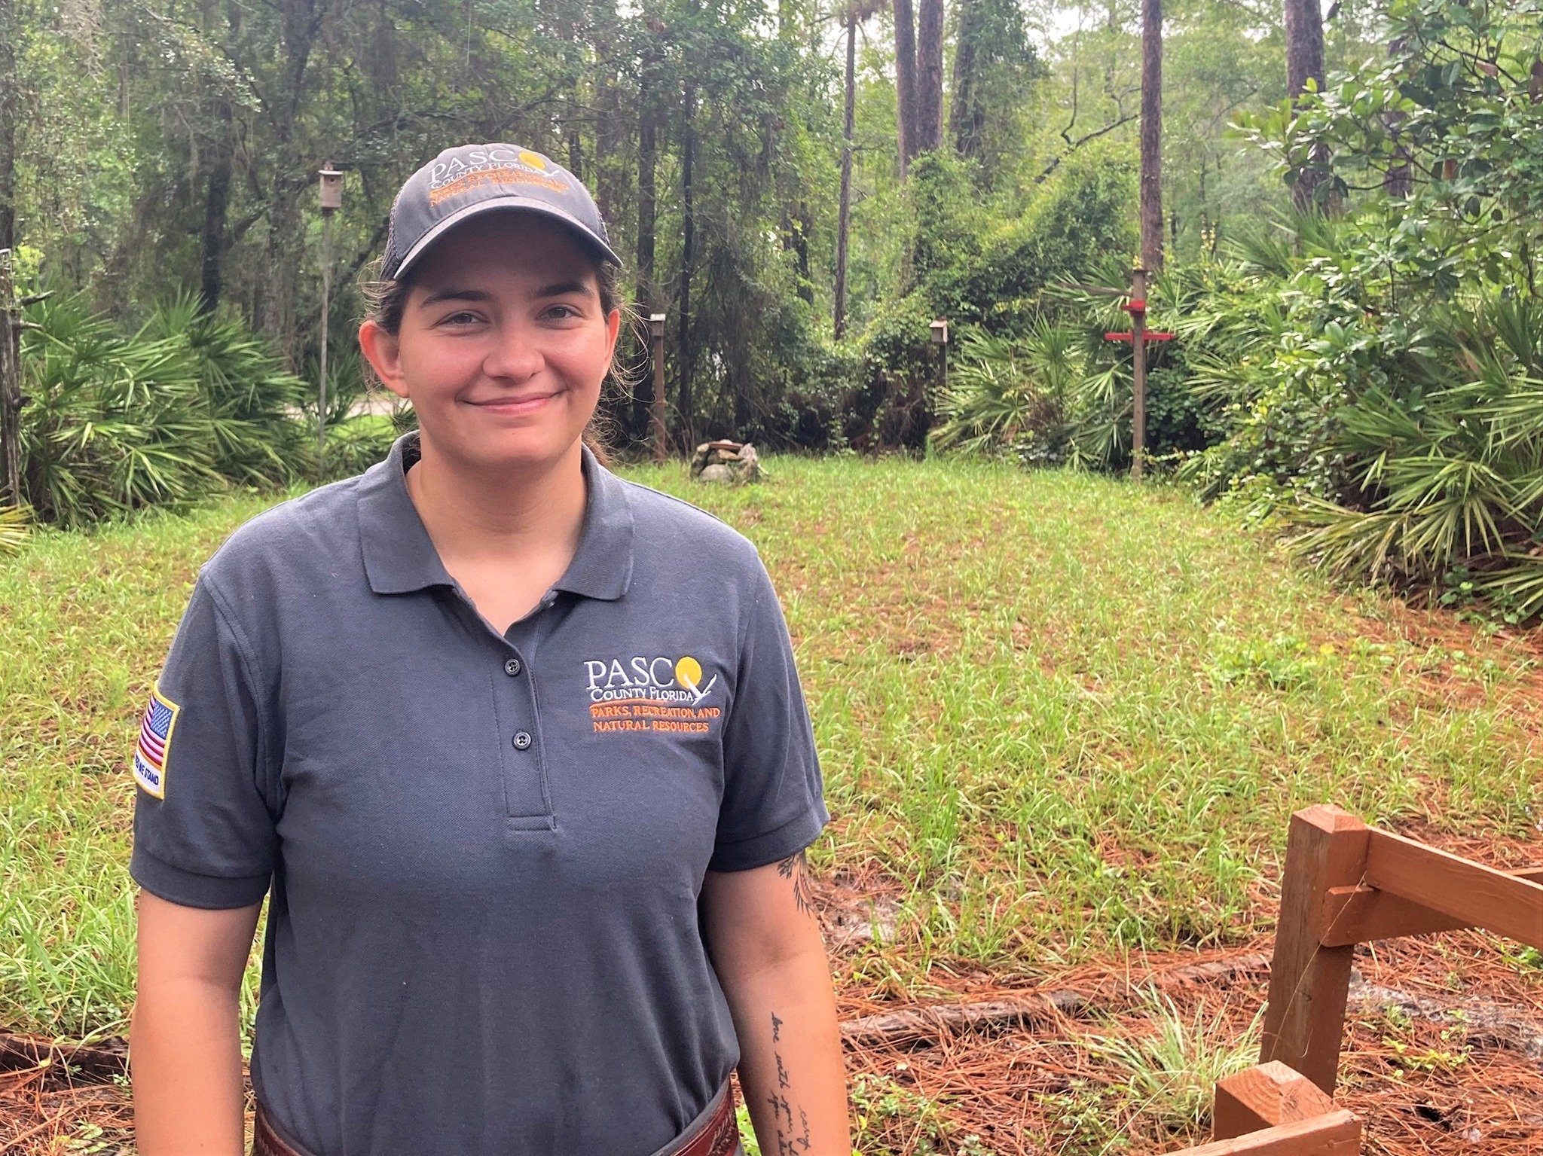
Lesson # 5
Make it personal; don’t just give them data, give them something to which they can relate.
43%
Of County Employees can only afford $1,337 or less per month in Housing Costs

Slide 15
For more information!
Marcy Esbjerg, MPA
Director
Pasco County Community Development
Pasco County, FL
mesbjerg@pascocountyfl.net

